Slide 1
Restaurant Table System
Spice Boys
Notes:
Josh

Slide 2
Introduction

Slide 3
The Scenario
An unnamed restaurant has contacted our software development company
Main problem is time inefficiency during busier hours:
Giving customers the opportunity to pay so they can leave
Providing customers the means to reserve tables without needing
In other words, the waiters, bussers, and hosts are overwhelmed during busier hours, causing customers to wait.
Notes:
Josh

Slide 4
Features of the System
Tablets at each table to place food orders, call waiters/waitresses and make card payments.
Seating feature that provides associates with an interactive graphic to observe the status of all tables.
Webapp that provides the means of making reservations and ordering take-out (with an online menu included).
Notes:
Josh

Slide 5
Requirements

Slide 6
Requirement: Table Status System (TSS)
The TSS provides a visualization of the physical layout of the tables in the restaurant which are colored according to the status of each individual table.
The TSS allows associates to manually override the status of any table and updates automatically with certain external stimuli (reservations made online, check paid from tablet, etc.).
Notes:
Kade

Slide 7
Requirements: Table Status System (TSS)
1.1. The TSS shall change the status of a table to “Reserved” when a customer reserves the table online, 15 minutes prior to the selected reservation time.
1.2. The TSS shall change the status of a table to “Seated” when an associate manually changes the status.
1.3. The TSS shall change the status of a table to “Calling Waiter” when a customer uses the Calling Waiter feature on his/her tablet.
1.4. The TSS shall change the status of a table to “Check Paid” when a customer makes a card payment on his/her tablet, or when a cash payment is made and an associate manually updates the table status.
1.5. The TSS shall change the status of a table to “Eating” when food is brought to the table and the table status is manually changed by an associate.
1.6. The TSS shall change the status of a table to “Empty”

Slide 8
Associate or Physical Restaurant
Customer
Table Status
1. Customer reserves table for a specific time frame
1.1 Change table status to “reserved” and make this table unavailable for reservation
1.3 TS only allows reserved party to sit at table
2. Customer is seated at table
2.1 Associate updates TS for table to “Seated”
3. Customer places food order
3.1(a) Associate delivers food to table
3.1(b) Associate updates TS for table to “Eating”
4. Customer requests assistance from associate at any time using tablet interface that communicates with TS
4.1 TS changes table status to “Calling Server”
4.2 TS notifies Associate of update to table
4.3 Associate tends to customer
5. Customer pays for food

Slide 9
5.1 TS updates table status to “Check Paid”
5.2 TS notifies Associate to check table for vacancy
5.3 Associate cleans table
6.1 Associate changes table status to “Empty”

Slide 10
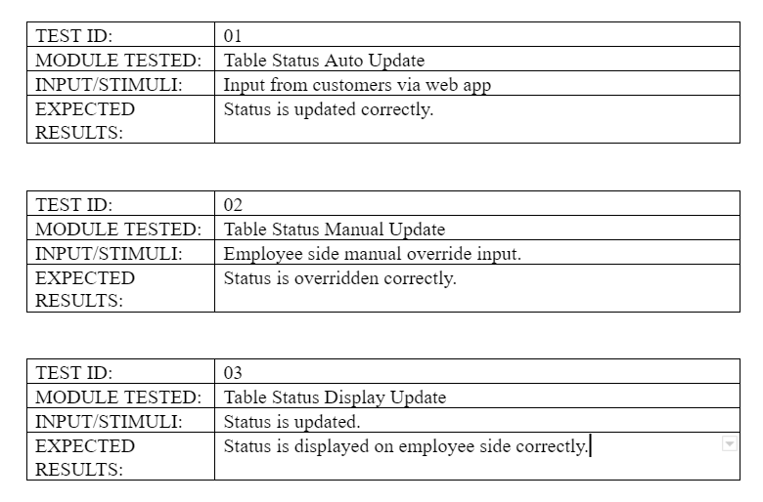
TSS Unit Testing

Slide 11
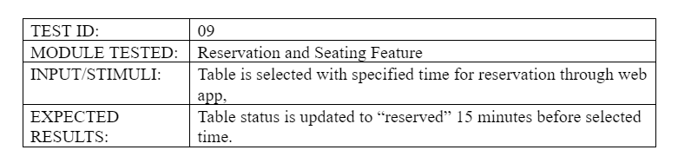
TSS Unit Testing

Slide 12
Requirements: Reservation and Seating Feature
The Reservation and Seating Feature is a means of remotely reserving table(s). The online service will provide the customer with a visualization of what tables are open and which ones reserved or currently occupied. In addition there will be a visual that displays typically heavy business hours for each day of the week.
Notes:
eric

Slide 13
Requirements: Reservation and Seating Feature
2.1. WebApp shall allow the customer selects time of reservation.
2.2. WebApp shall display all available tables at the customer’s specified time of arrival in the physical layout of the restaurant.
2.3. WebApp shall notify Table Status System (TSS) that the selected tables are reserved for the specified time.

Slide 14
Seating and Reservation Feature
Customer
WebApp
Table Status
Associate
1. Customer selects reservation time
1.1 WebApp allows Customer to specify table (table must be available)
2.1 Customer selects a table
2.1 WebApp tells TS to change table status to “Reserved” 30 minutes prior to reservation time
2.2 TS changes status of table to “Reserved” 30 minutes prior to reservation time
2.3 TS notifies Associate that table is reserved
2.4 Associate only sits reserved party at table upon party’s arrival

Slide 15
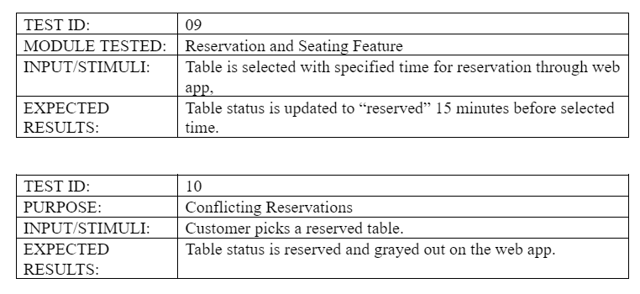
Seating and Reservation Feature Unit Testing

Slide 16
Requirements: Tablet Feature
3.1. Tablet shall provide customer with an interactive touch screen.
3.2. Tablet shall provide a card reader to gather payment information.
3.3. Tablet shall have low latency in alerting the status of the table, sending orders, and processing payments.
3.4. Tablet at table shall allow customer to notify an associate for assistance.
Notes:
hector

Slide 17
Customer
Tablet Ordering System
Order Queue
Associate
1. Customer places food order to TOS
1.1 TOS adds order to OQ
1.2 TOS adds items to running tab for the table
1.3 OQ tells the kitchen what food to prepare next
1.4 Kitchen prepares food
1.5 Kitchen removes food item from OQ
1.6 Associate delivers food to table
2. Customer presses button on TOS to end and pay tab
2.1 TOS asks Customer if payment will be cash or card
3. Customer selects payment type
3.1(a) If Customer selects cash, an associate is notified through “Call Server” status on TS
Notes:
Hector
Ordering use case

Slide 18
3.2(a) Associate assists Customer with Cash Payment
3.1(b) If Customer selected card, Customer is prompted to insert card to TOS
4. Customer inserts card to TOS
4.1 TOS prompts Customer to select a tip amount
5. Customer selects tip amount
5.1 TOS processes payment and prints receipt
6. TOS removes running tab from TOS

Slide 19
Customer
Waiting Button System
Table Status System
Associate
1. Customer presses button to indicate they need assistance
1.1 WB tells TS what table needs assistance
1.2 TS changes table status to “Calling Server”
1.3 TS notifies Associate of the update in table’s status
1.4 Associate tends to table
Notes:
Waiting feature

Slide 20
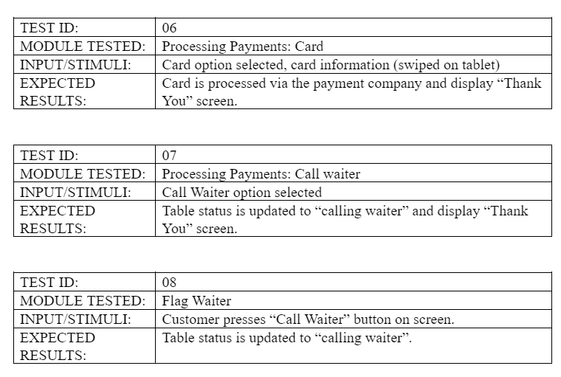
Tablet Feature Unit Testing

Slide 21
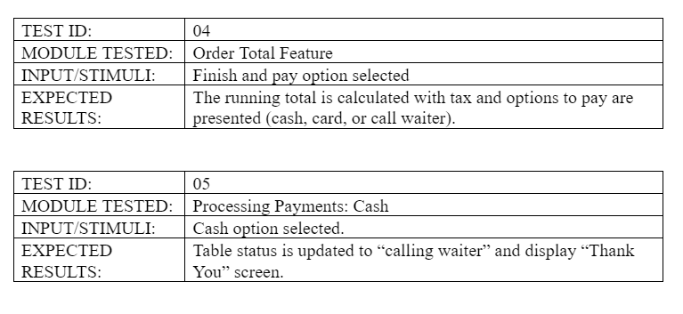
Tablet Feature Unit Testing

Slide 22
Object Diagrams
Notes:
David

Slide 23
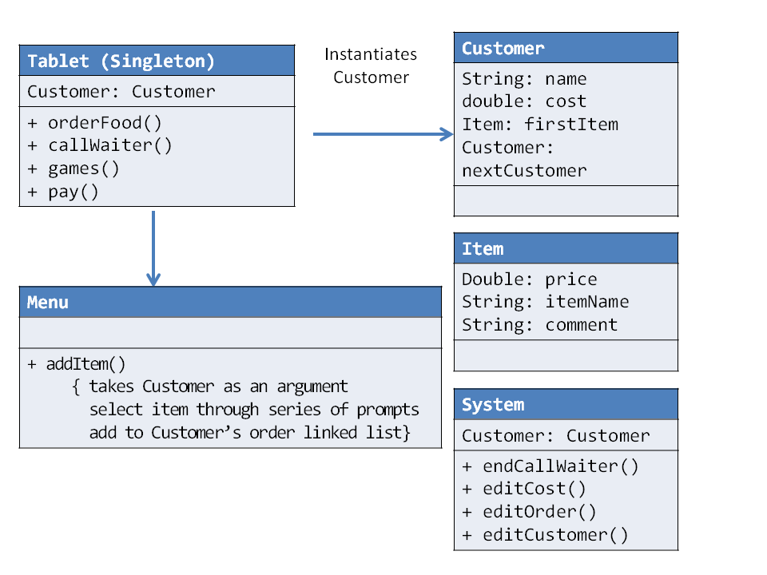
Object Diagrams
Notes:
David

Slide 24
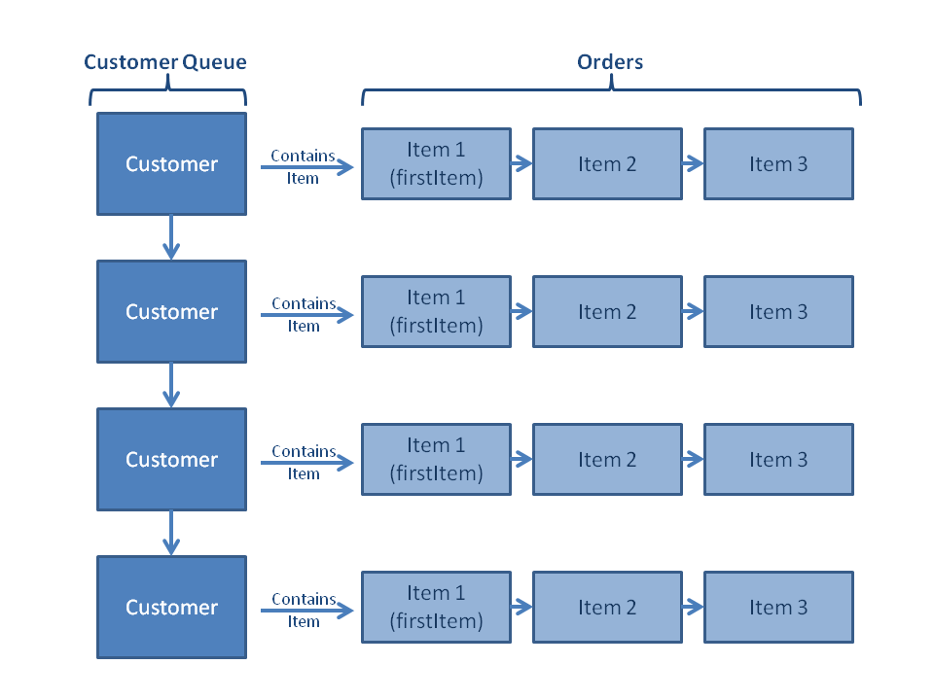
Object Diagrams
Notes:
David

Slide 25
System Testing
Notes:
Max

Slide 26
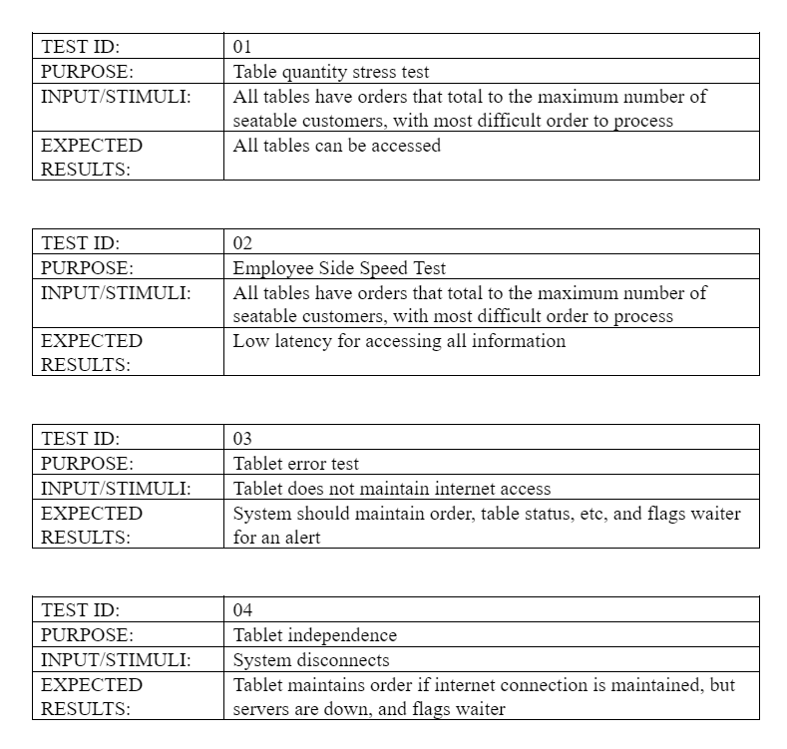
Notes:
Max

Slide 27
Integration Testing
Notes:
max

Slide 28
Integration Testing
When a reservation is placed on the webapp, the table status feature must reserve the table.
When a reservation is canceled through the webapp, the table status feature must allow the table to be reserved by another party.
When a customer flags a waiter with the tablet, the table status feature must update the table on the table status feature.
When a customer places a new food order, the items ordered must be added to an ordering queue for the kitchen to know what food to prepare next.
When a customer closes the running tab and pays the restaurant, the table status feature must update the status of the table to “Empty”.
Notes:
Max

Slide 29
Thank You
Spice Boys
Notes:
Max

